Slide 1
Naive Bayes

Slide 2
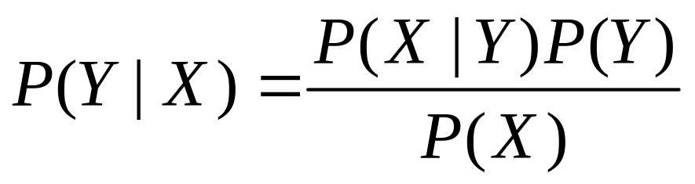
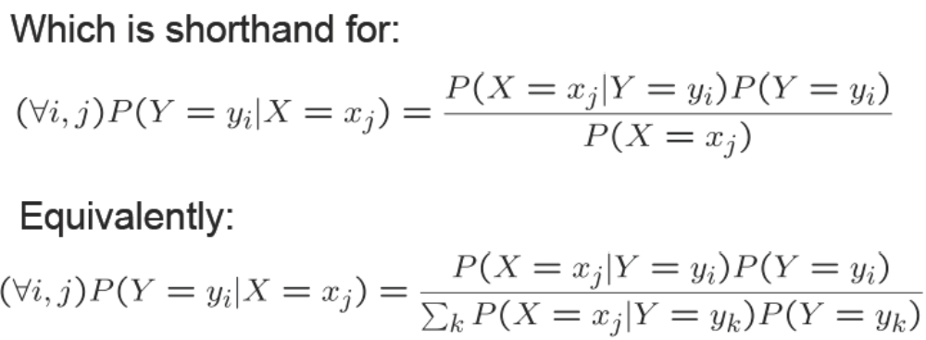
Bayes Rule

Slide 3
Num. of params using Bayes Rule?
Suppose X=<X₁,…X_{n}>, where X_{i} and Y are boolean RV’s
How many parameters for P(X₁,X₂,..X_{n}|Y) (2^{n}-1)*2?
How many parameters for P(Y) 1?
So total #{params} is?

Slide 4
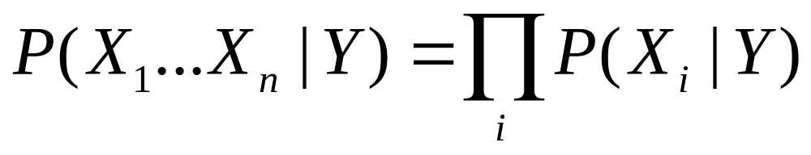
Naive Bayes
Naive Bayes assumes
i.e., that X_{i} and X_{j} are conditionally independent given Y, for all i != j

Slide 5
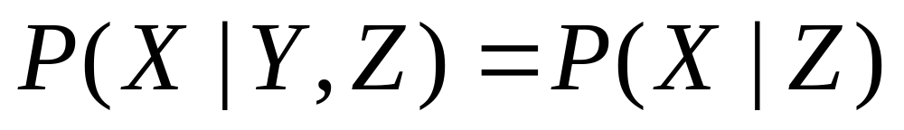
Conditional Independence
Definition: X is conditionally independent of Y given
Z, if the probability distribution governing X is
independent of the value Y, given the value of Z
Which we often write

Slide 6
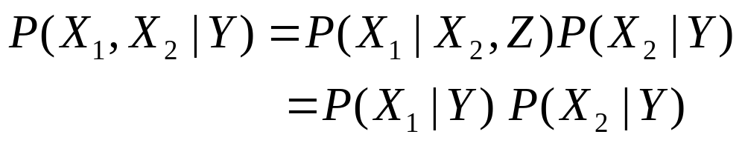
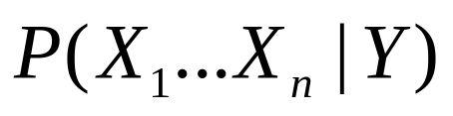
Naive Bayes
Naive Bayes uses assumption that the X_{i} are conditionally independent, given Y
Given this assumption, then
How many parameters to describe and
P(Y) : 2n+1, why?

Slide 7
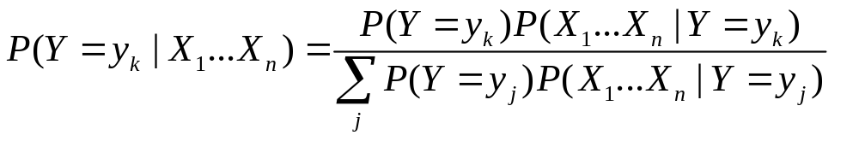
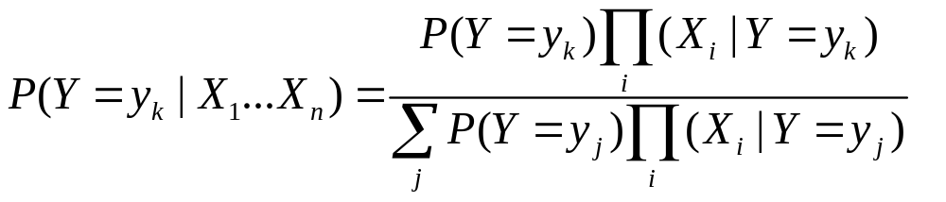
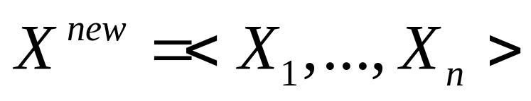
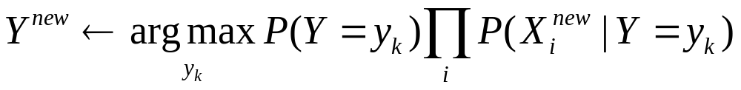
Naive Bayes
Bayes rule:
Assuming conditional independent among X_{i}’s:
So, classification rule for is:

Slide 8
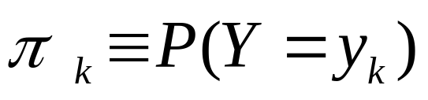
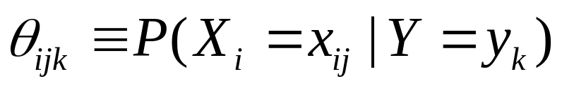
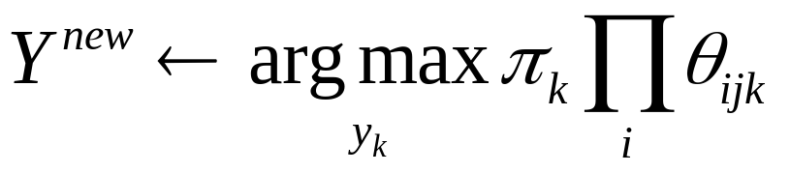
Naive Bayes Algorithm – discrete X_{i}
Train Naive Bayes (examples)
for each value y_{k}, estimate
for each value x_{ij} of each attribute X_{i}
estimate
Classify (X^{new})
* Probabilities must sum to 1, so need estimate only n-1 of these…

Slide 9
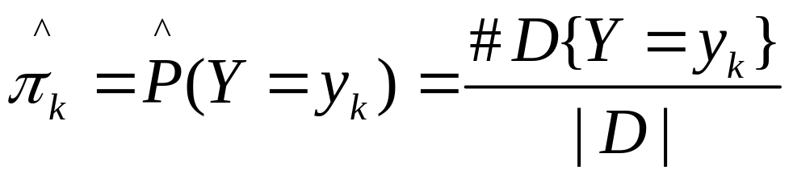
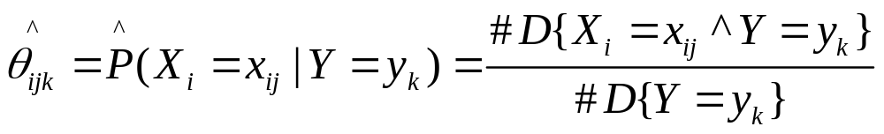
Estimating Parameters: Y, X_{i} discrete-valued
Maximum likelihood estimates (MLE):
Number of items in dataset D for which Y=y_{k}

Slide 10
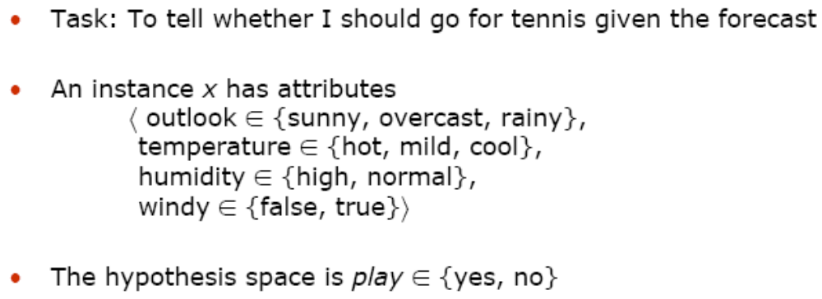
Example: Play Tennis?

Slide 11
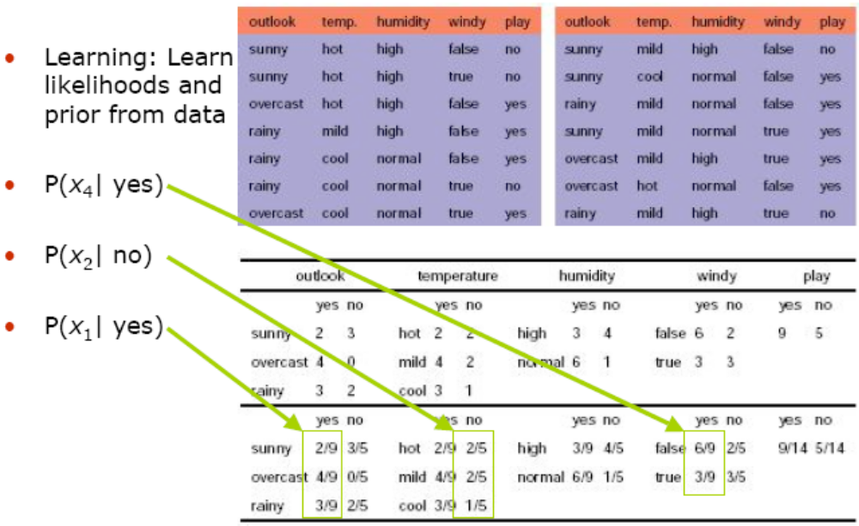

Slide 12
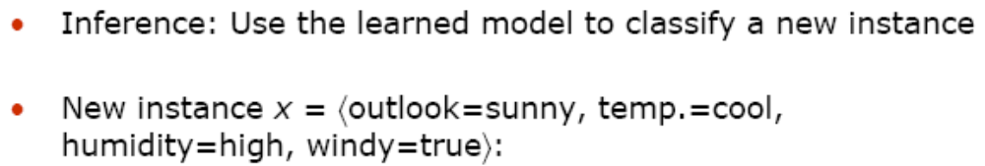
Example: Play Tennis?

Slide 13
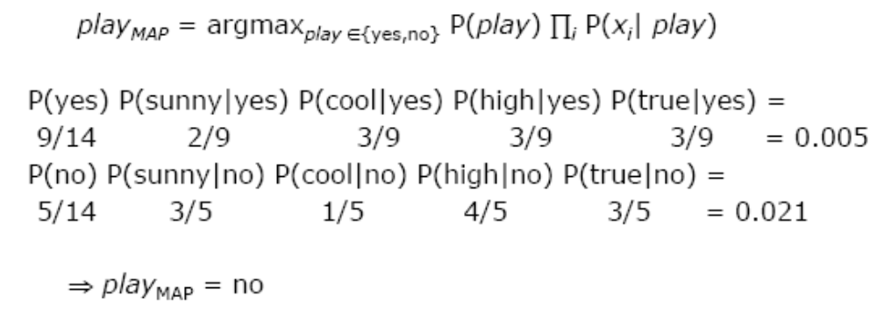
Example: Play Tennis?

